Slide 1
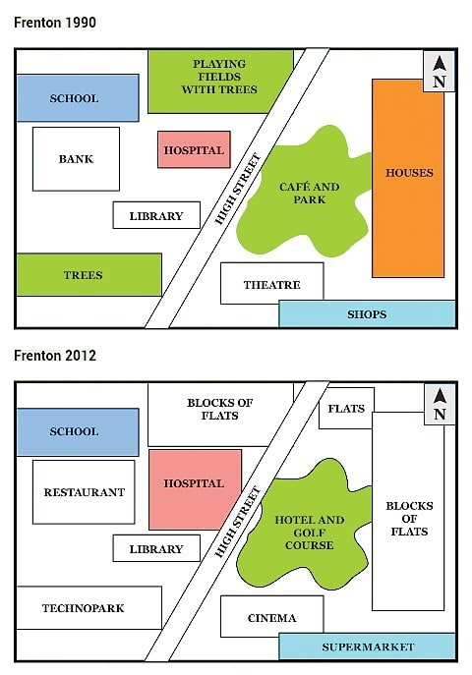
MAP

Slide 2
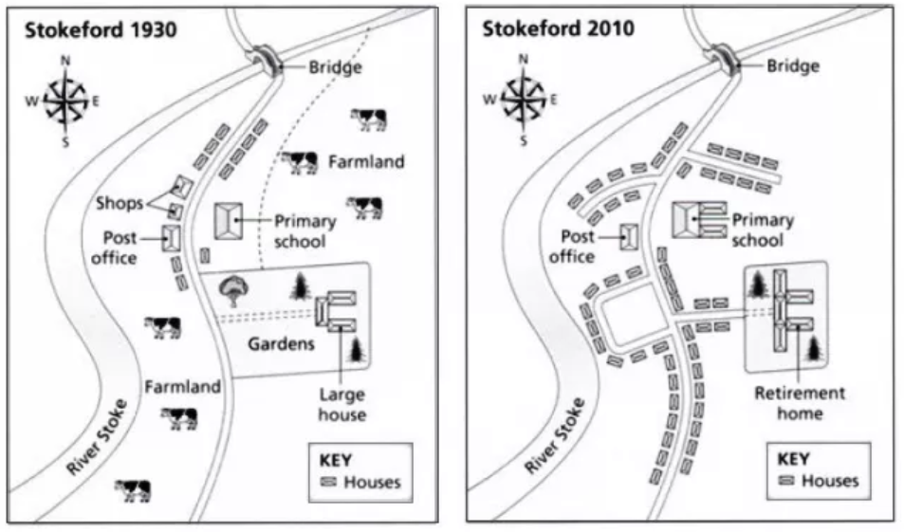
The maps below show the village of Stokeford in 1930 and 2010.
Summarise the information by selecting and reporting the main features, and make comparisons where relevant.
Write at least 150 words.

Slide 3
SAMPLE ANSWER
The two maps illustrate how the village of Stokeford, situated on the east bank of the River Stoke, changed over an 80 year period from 1930 to 2010. There was considerable development of the settlement over these years and it was gradually transformed from a small rural village into a largely residential area.
The most notable change is the presence of housing in 2010 on the areas that were farmland back in 1930. New roads were constructed on this land and many residential properties were also built. Along with the considerable increase in houses, the primary school was extended to around double the size of the previous building.
Whilst the post office remained as a village amenity, the two shops that can be seen to the north-west of the school in 1930, no longer existed by 2010, having been replaced by houses. There also used to be an extensive property standing in its own large gardens situated to the south-east of the school. At some time between 1930 and 2010, this was extended and converted into a retirement home. This was another significant transformation for the village.
(187 words)

Slide 4
BREAKDOWN AND EXPLANATION

Slide 5
Identify the Main Features
1) What time periods are shown?
Are the maps of past, present or future situations? This is important to note because it will determine whether you write your essay using past, present or future tenses.
The two maps in our practice IELTS map question show the village of Stokeford at two different times in the past. This immediately tells us that we will need to use the past tense in our essay.
2) What are the main differences between the maps?
What features have disappeared? What new features are in their place?
3) What features have remained the same over the time period?
Although the location on the maps will have undergone major development, some features may remain unchanged.

Slide 6
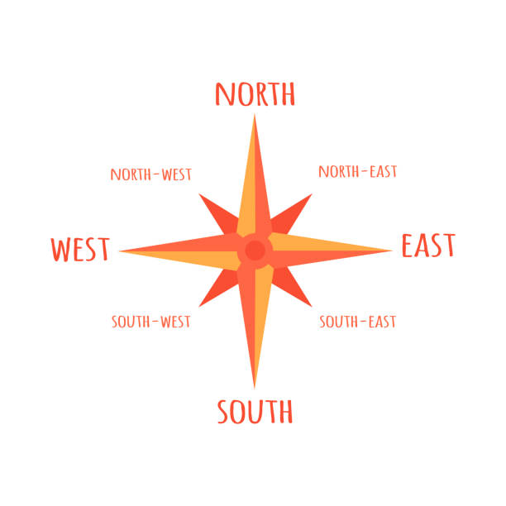
Directions
Also, think about directional language you can use, such as:
north
south
east
west
north-east
north-west
south-east
south-west

Slide 7
Identify the Main Features
Main feature 1: The farmland has been built on.
Main feature 2: The large house has been converted into a retirement home.
Main feature 3: The school has been enlarged.
Main feature 4: The shops have disappeared.

Slide 8
Write an Introduction
Question:
The maps below show the village of Stokeford in 1930 and 2010.
Introduction (Paragraph 1):
The two maps illustrate how the village of Stokeford, situated on the east bank of the River Stoke, changed over an 80 year period from 1930 to 2010.
DO NOT GIVE ANY HEADING
THE HEADINGS OF THE PARAGRAPHS ARE FOR EXPLANATION ONLY
YOUR WRITING SHOULD ONLY HAVE PARAGRAPHS AS SHOWN IN THE LAST SLIDE

Slide 9
Write an Overview
Main feature 1: The farmland has been built on.
Main feature 2: The large house has been converted into a retirement home.
Main feature 3: The school has been enlarged.
Main feature 4: The shops have disappeared.
Overview-Paragraph-1
There was considerable development of the settlement over these years and it was gradually transformed from a small rural village into a largely residential area.
DO NOT GIVE ANY HEADING
THE HEADINGS OF THE PARAGRAPHS ARE FOR EXPLANATION ONLY
YOUR WRITING SHOULD ONLY HAVE PARAGRAPHS AS SHOWN IN THE LAST SLIDE

Slide 10
Paragraph-1 (Intro+Overview)
The two maps illustrate how the village of Stokeford, situated on the east bank of the River Stoke, changed over an 80 year period from 1930 to 2010. There was considerable development of the settlement over these years and it was gradually transformed from a small rural village into a largely residential area.
DO NOT GIVE ANY HEADING
THE HEADINGS OF THE PARAGRAPHS ARE FOR EXPLANATION ONLY
YOUR WRITING SHOULD ONLY HAVE PARAGRAPHS AS SHOWN IN THE LAST SLIDE

Slide 11
Write the 1st Detail Paragraph
Main feature 1: The farmland has been built on.
Main feature 3: The school has been enlarged.
Paragraph 2:
The most notable change is the presence of housing in 2010 on the areas that were farmland back in 1930. New roads were constructed on this land and many residential properties were also built. Along with the considerable increase in houses, the primary school was extended to around double the size of the previous building.
DO NOT GIVE ANY HEADING
THE HEADINGS OF THE PARAGRAPHS ARE FOR EXPLANATION ONLY
YOUR WRITING SHOULD ONLY HAVE PARAGRAPHS AS SHOWN IN THE LAST SLIDE

Slide 12
Write the 2nd Detail Paragraph
Main feature 2: The large house has been converted into a retirement home.
Main feature 4: The shops have disappeared.
Paragraph 3:
Whilst the post office remained as a village amenity, the two shops that can be seen to the north-west of the school in 1930, no longer existed by 2010, having been replaced by houses. There also used to be an extensive property standing in its own large gardens situated to the south-east of the school. At some time between 1930 and 2010, this was extended and converted into a retirement home. This was another significant transformation for the village.
DO NOT GIVE ANY HEADING
THE HEADINGS OF THE PARAGRAPHS ARE FOR EXPLANATION ONLY
YOUR WRITING SHOULD ONLY HAVE PARAGRAPHS AS SHOWN IN THE LAST SLIDE

Slide 13
SAMPLE ANSWER
The two maps illustrate how the village of Stokeford, situated on the east bank of the River Stoke, changed over an 80 year period from 1930 to 2010. There was considerable development of the settlement over these years and it was gradually transformed from a small rural village into a largely residential area.
The most notable change is the presence of housing in 2010 on the areas that were farmland back in 1930. New roads were constructed on this land and many residential properties were also built. Along with the considerable increase in houses, the primary school was extended to around double the size of the previous building.
Whilst the post office remained as a village amenity, the two shops that can be seen to the north-west of the school in 1930, no longer existed by 2010, having been replaced by houses. There also used to be an extensive property standing in its own large gardens situated to the south-east of the school. At some time between 1930 and 2010, this was extended and converted into a retirement home. This was another significant transformation for the village.
(187 words)

